Slide 1


PROBLEM STATEMENT TITLE: OPEN INNOVATION CHALLENGE. TEAM NAME: TECH WIZARDS INSTITUTION NAME: SOUNDARYA INSTITUTION OF MANAGEMENT AND SCIENCE. THEME NAME: CLIMATE CHANGE.
STUDENT BRACH CODE: IEEE STUDENT BRANCH STB60213367, BENGLURU SECTION
TEAM LEADER: Arpitha Reddy B J
TEAM MEMBERS: Varsha R
Sujal Prasad
Joy Sheety

Slide 2

PREDICTION OF FOREST FIRE BASED ON HUMIDITY,SMOKE AND TEMEPERATURE

Slide 3
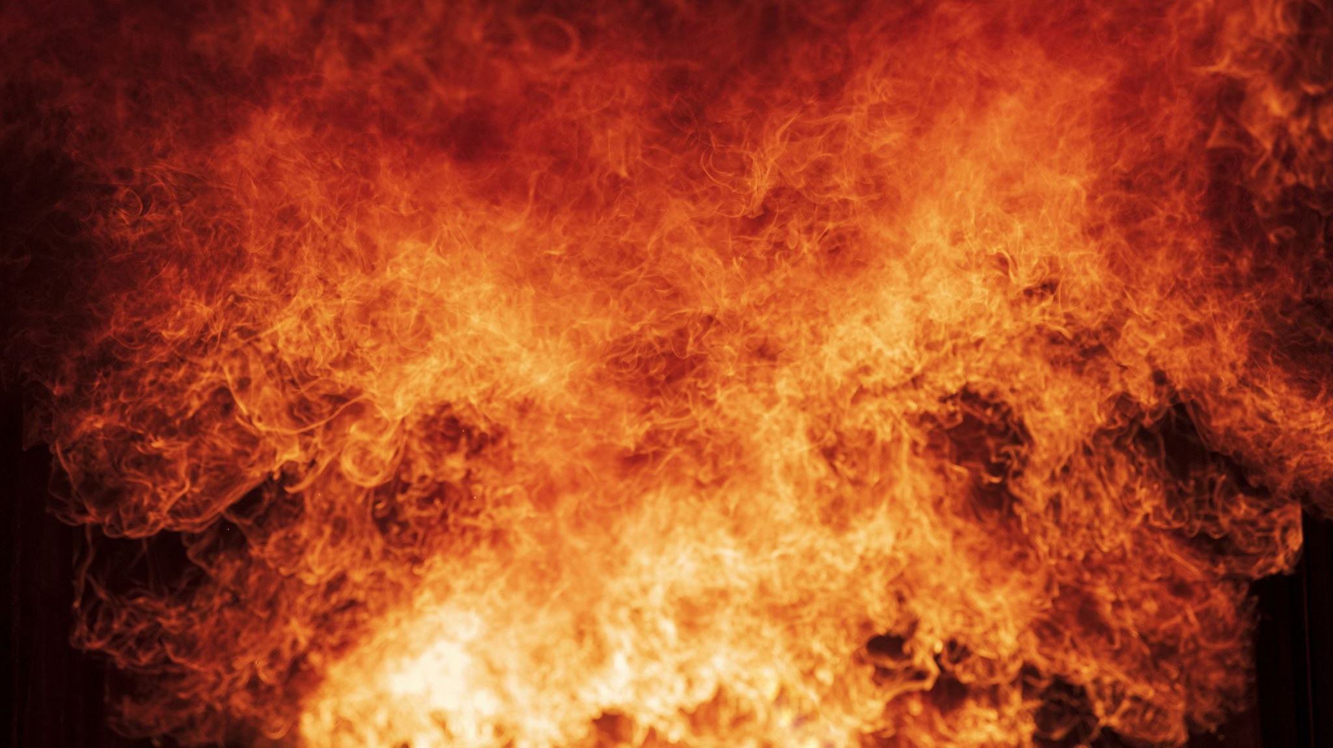
PROBLEM
Forest fires are a major problem around the world, causing widespread damage and destruction Traditional methods of detection and prevention are often insufficient, leading To devastating consequences.
10/8/2023
Sample Footer Text

Slide 4
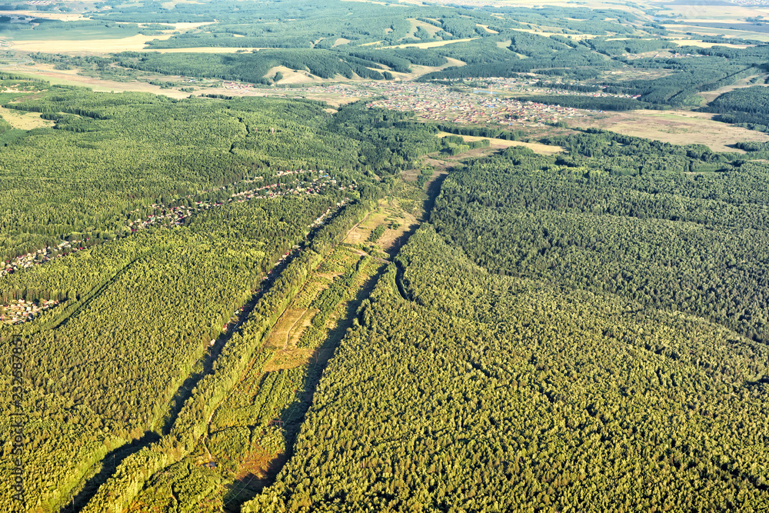
Steps taken to Solution
Identifying the forest area:
Aerial photographs, taken from aircraft or drones, can provide high-resolution images of forested areas and may be useful for identification and monitoring.

Slide 5
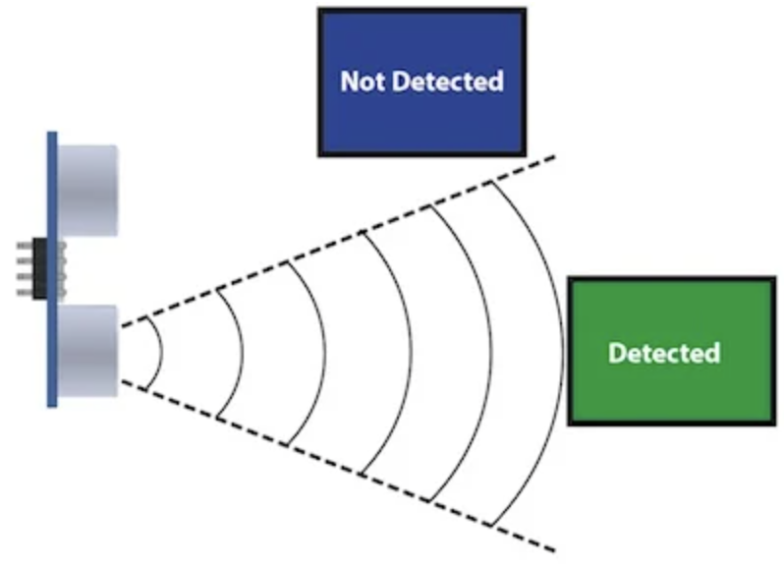
Choose the range of sensors:
First, understand the range of values you need to measure. For example, if you are measuring temperature, consider the expected minimum and maximum temperatures in your application.
Consider the dynamic range of your measurement. This refers to the difference between the smallest and largest values you need to measure. Ensure that the sensor's range covers this dynamic range adequately.

Slide 6
To calculate Area into segments
Ex: Segments = Total area / Range of sensor.
Segments = 10000 sqm/500sqm
=200
Maximum range | Degree
Humidity | 30
Temperature | 49
Smoke | 90

Slide 7
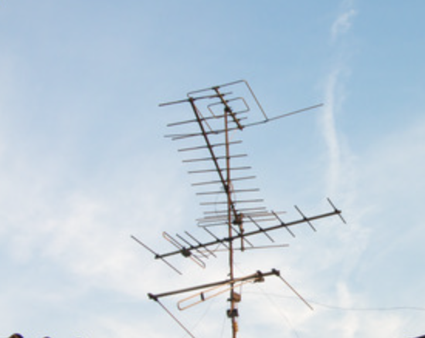
Installation
In this we will be attaching Temparature sensors and smoke detecting sensors. Temperature Sensors are used to detect Real time value of the temperature in celsius.
Smoke detecting sensors are used to Detect smoke and message is send to the control regarding detection of smoke and prevention is taken to control the smoke.

Slide 8
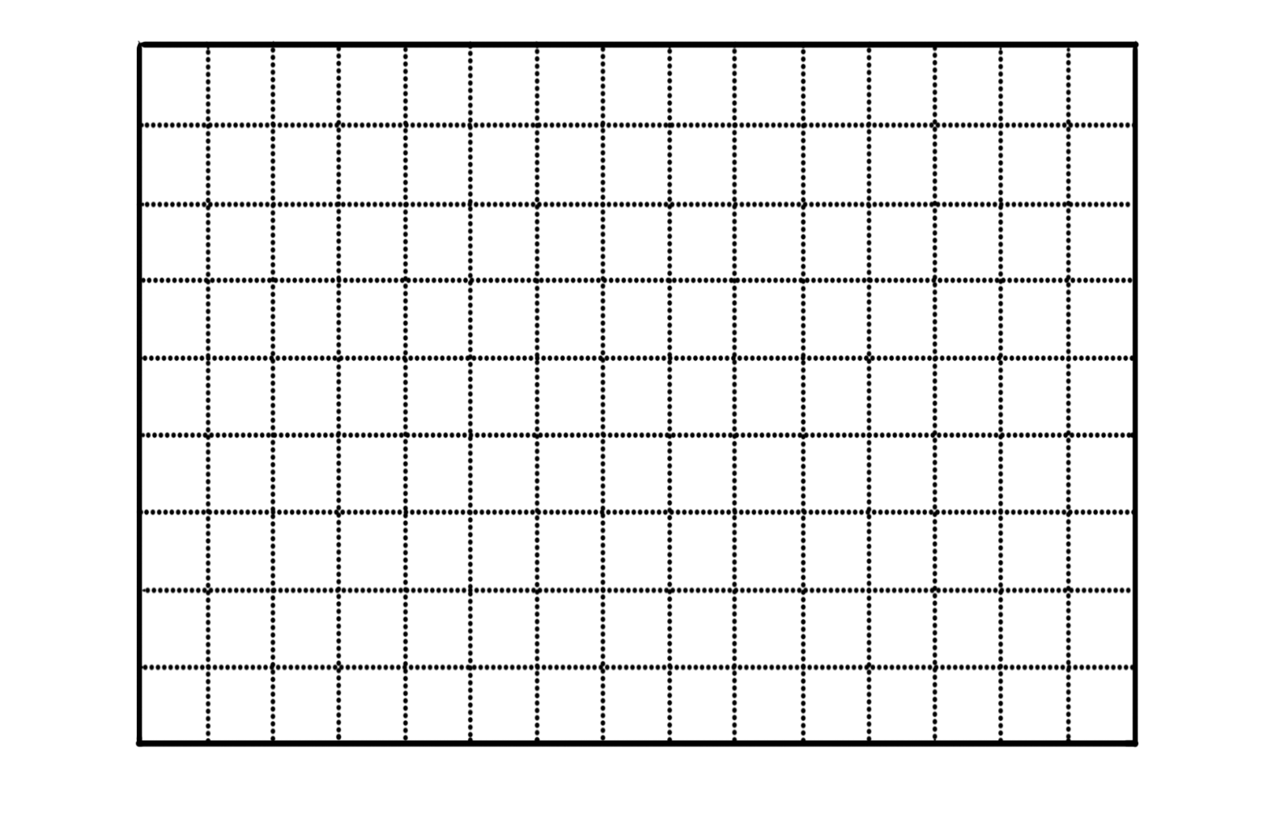
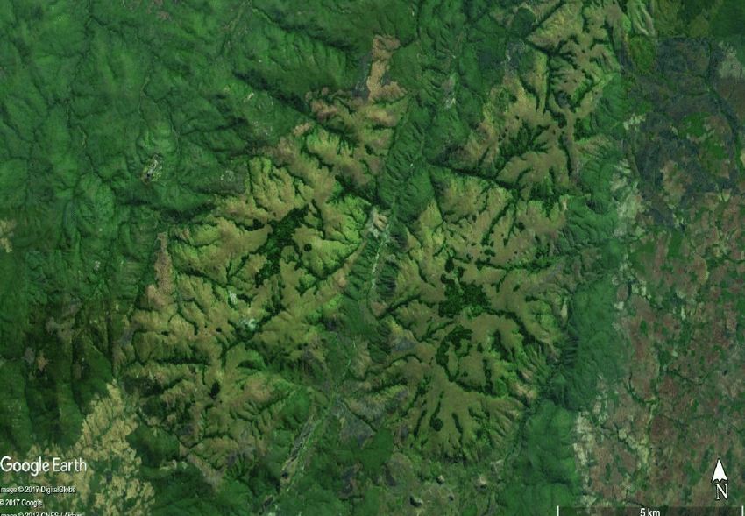
Architectural view of grid mode
Each sensors have their own range. So according to the sensor range the area is divided into segments.
The sensors which are placed in each segment is connected to a individual module . And that modules is sent to the control room.
In control room we can view the temperatures and smokes and can be predicted using the forest fires.

Slide 9

Working Algorithm
Safe mode(green):
Humidity, Smoke, Temperature are in control. And data is sent to local department. Which is denoted in green light symbol
This Photo by Unknown Author is licensed under CC BY-SA

Slide 10

Reorder mode(orange mode):
Humidity , temperature and smoke levels indicate approaching danger. Sends data to local and central forest authorities.

Slide 11

Danger mode(red mode):
Humidity, smoke and temperature levels indicate that the forest has caught fire, and the alert message is sent to local and central forest authorities including the weather forecast department.
The further actions are taken care by the departments to ensure minimum loss during forest fire.

